Slide 1
Brain Tumor Detection From Mri Images With Ibm Watson Studio

Slide 2
GROUP
SREERAM RUPESH 19BCY10089
VIGNESH 19BAI10107
SHANJAY KUMAR M 19BCY10132

Slide 3
INTRODUCTION
A brain tumor is a collection, or mass, of abnormal cells in your brain. Your skull, which encloses your brain, is very rigid. Any growth inside such a restricted space can cause problems. Brain tumors can be cancerous (malignant) or noncancerous (benign). When benign or malignant tumors grow, they can cause the pressure inside your skull to increase. This can cause brain damage, and it can be life-threatening.

Slide 4
PROBLEM STATEMENT:
The process of detection of tumors from MRI images of a brain is one of the highly focused areas in the community of medical science as MRI is noninvasive imaging. Radiologists are specialists who deal with detection and segmentation of brain tumors from MRI scans in their day-to-day lives, but it is possible to exhaust these specialists by burdening them with a surfeit of scans to analyse-- due to a plethora of reasons. This would not only cause a delay in analyses, but also cause them to flag, thereby increasing the chances of errors in diagnosis as a result of over-work and fatigue.

Slide 5
OBJECTIVE
The aim of this project is to develop an image classification application, which analyzes the input MRI scans and accurately determines the presence of a tumor . Convolutional neural networks (CNN) implemented using necessary python libraries on IBM Watson Studio and Jupyter Notebook can be used to develop the model required to classify MRI images. Flask is used to integrate the deep learning model with a web user interface.

Slide 6
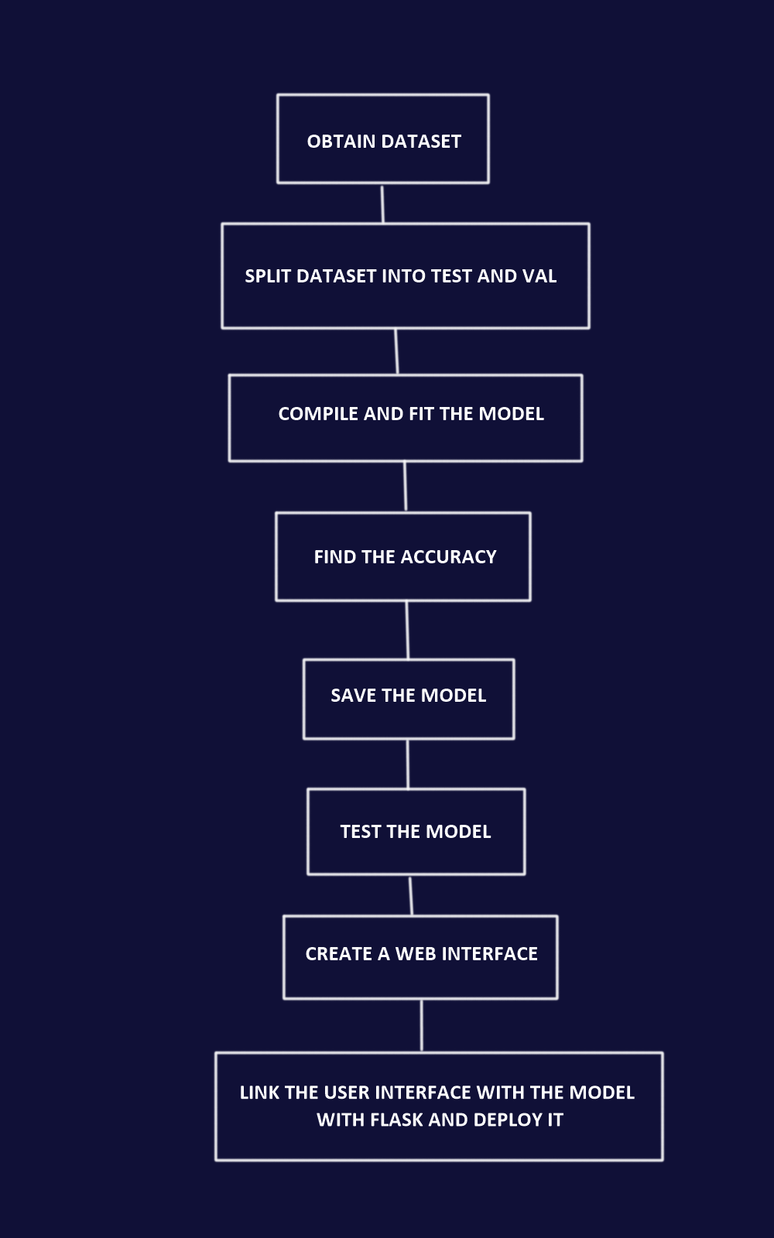
WORK FLOW

Slide 7
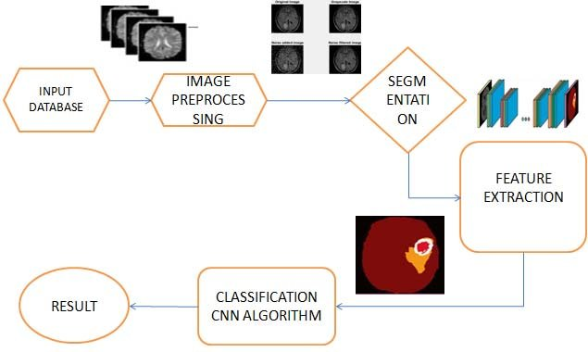
PROPOSED ARCHITECTURE

Slide 8
HW/SW Components Used
Windows OS (preferably)
Anaconda
IBM Watson Studio and Relevant python libraries such as tensorflow, keras, ibm_watson_machine_learning and opencv2 are some basic libraries necessary to work on this project.
A system with 8GB RAM and a processor with i5 core and above (7th generation +) would satisfy the requirements for building deep-learning models.

Slide 9
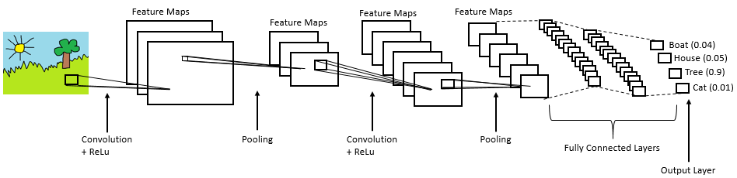
Layout of CNN model

Slide 10
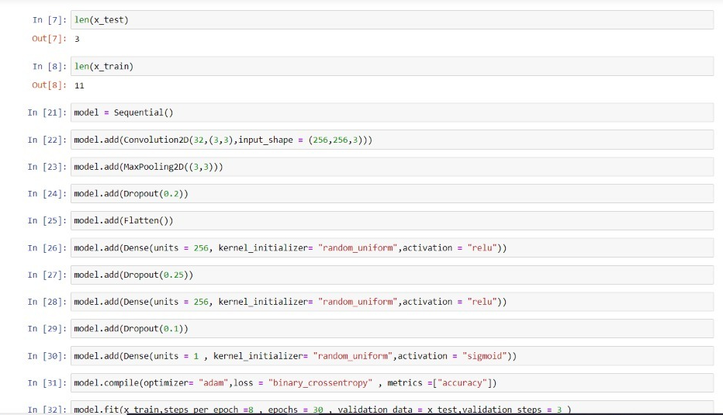
MODEL BUILDING

Slide 11
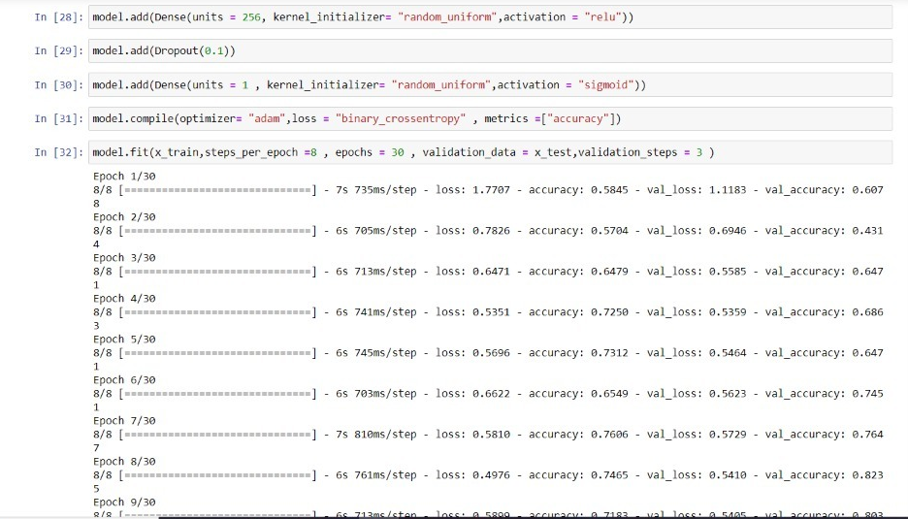

Slide 12
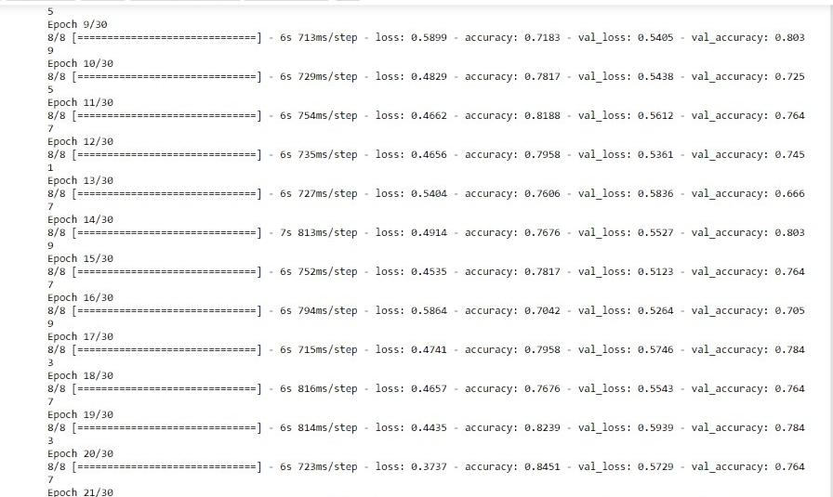

Slide 13
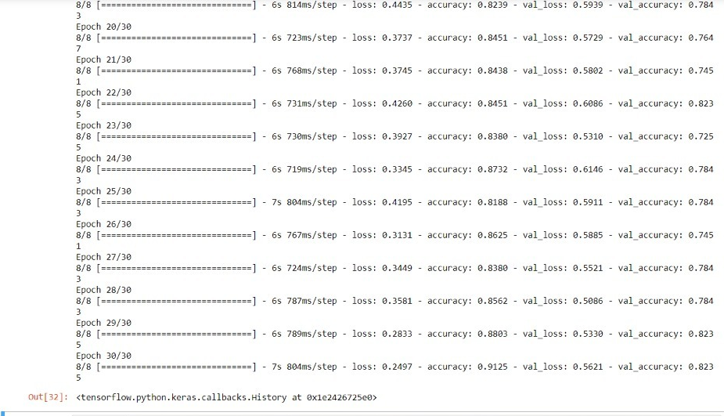

Slide 14
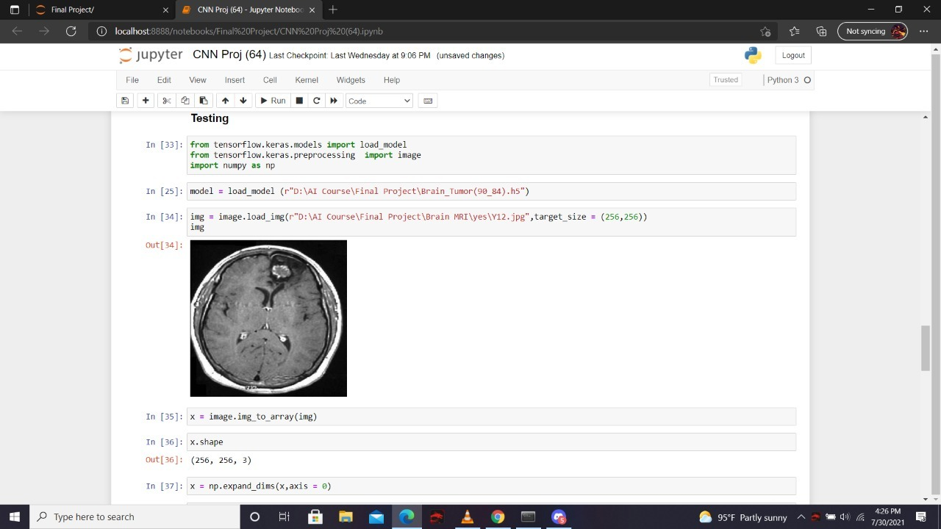
TESTING MODEL

Slide 15
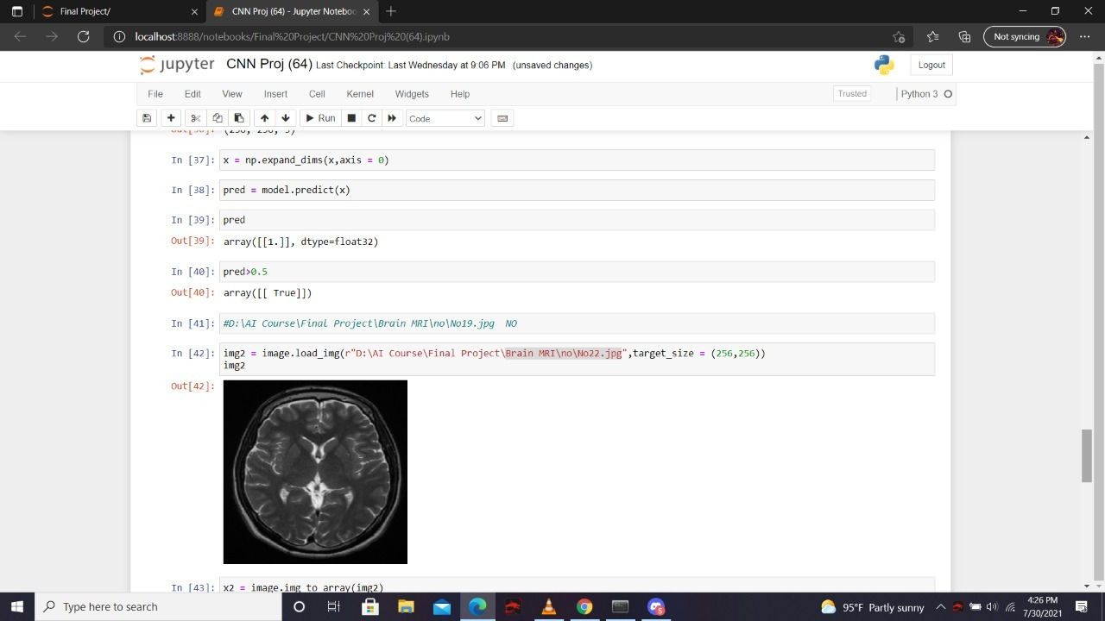
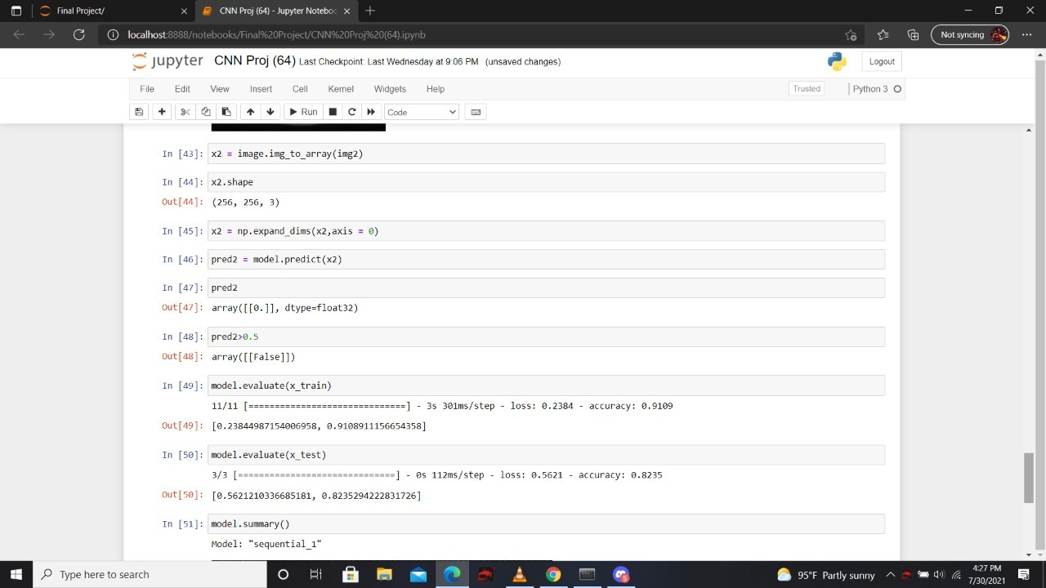

Slide 16
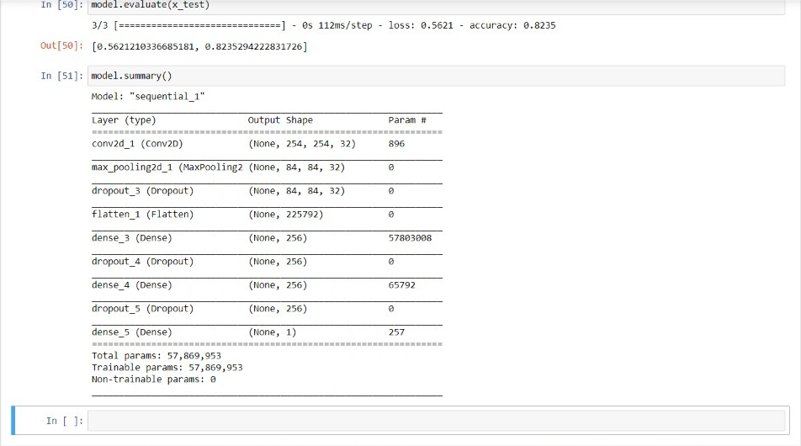
MODEL EVALUATION

Slide 17
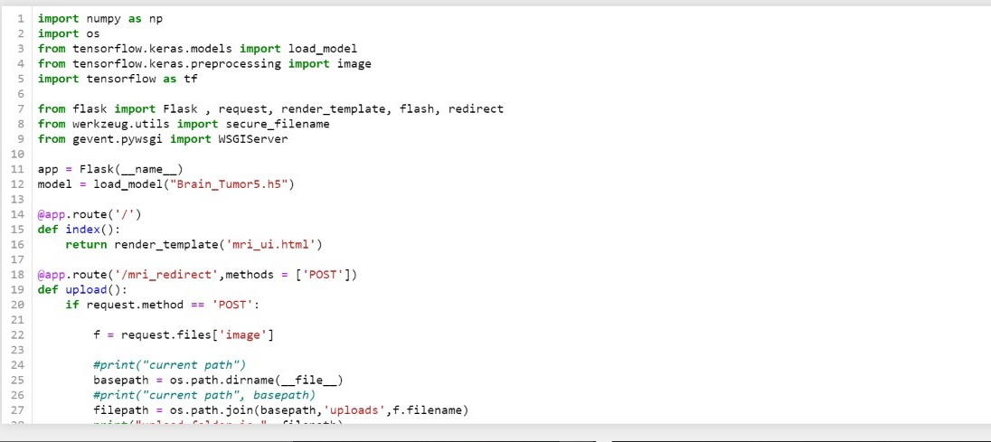
PYTHON CODE

Slide 18
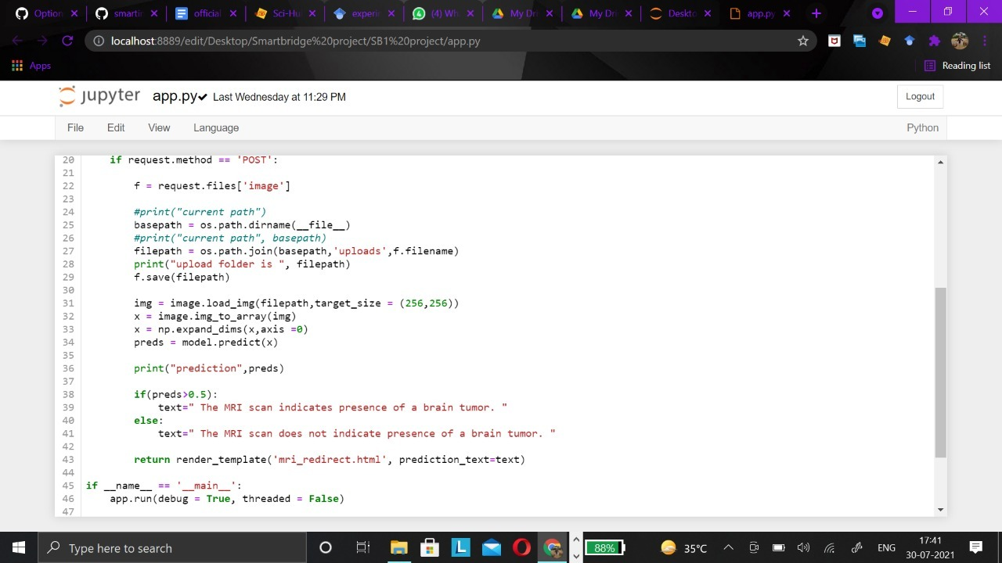

Slide 19
RUNNING THE APPLICATTION

Slide 20
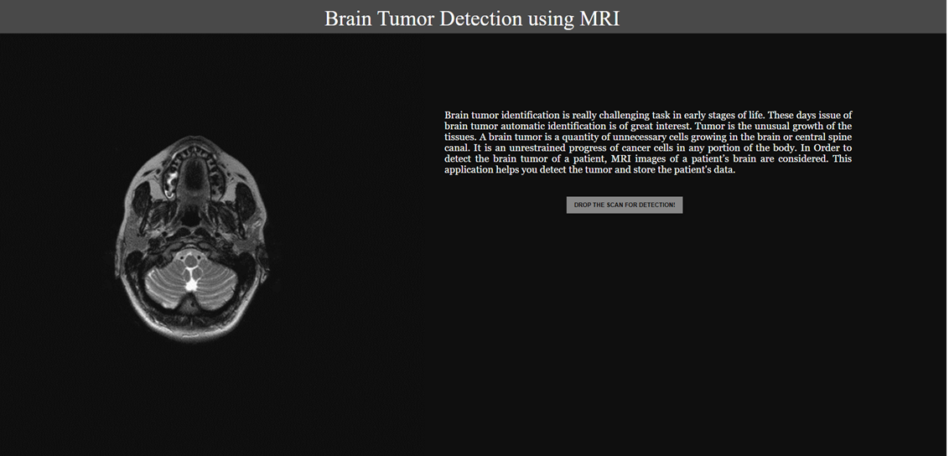
UI – HOME PAGE

Slide 21
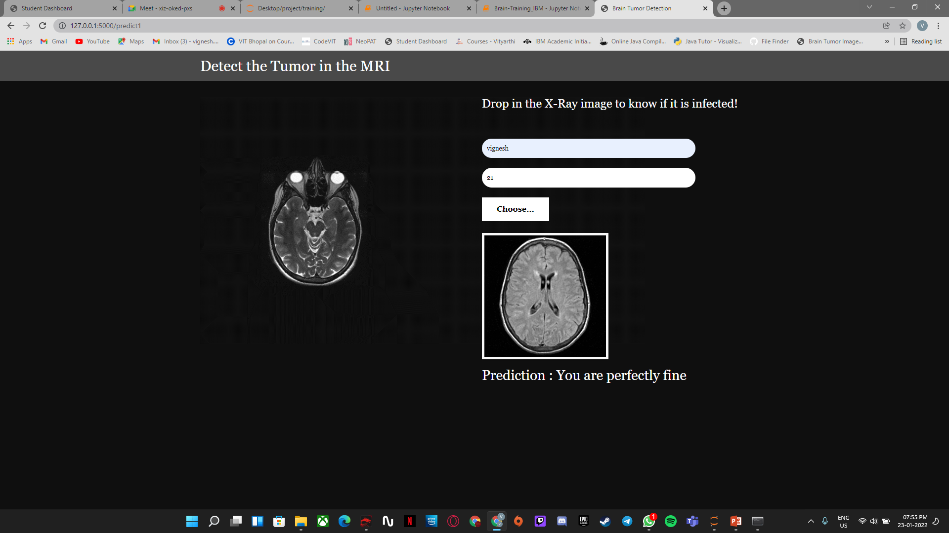
UI – PREDICTED RESULT

Slide 22
CONCLUSION
The model developed shows promising results with a relatively high accuracy--thereby making it appropriate to deem the model as extremely efficient--and the user-friendly interface only makes it easy for users to understand and work with.

Slide 23
THANK YOU

